Slide 1

Convolutional Neural Networks
Padding
deeplearning.ai

Slide 2


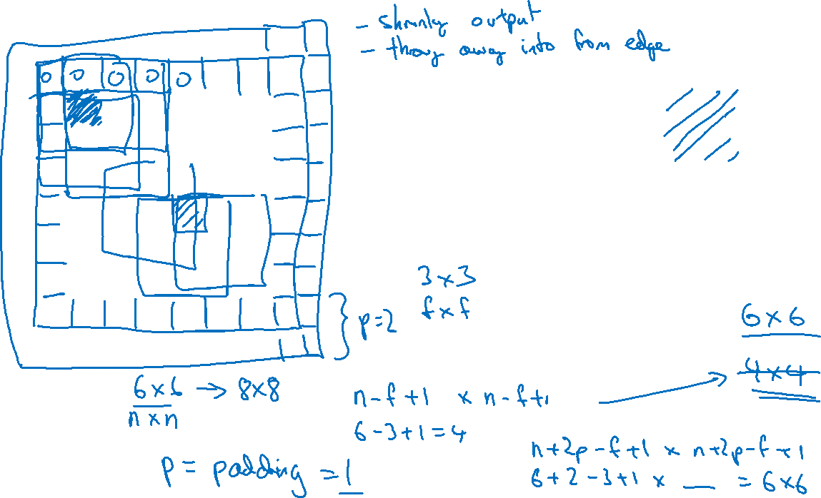
Padding
$$∗$$
$$=$$

Slide 3
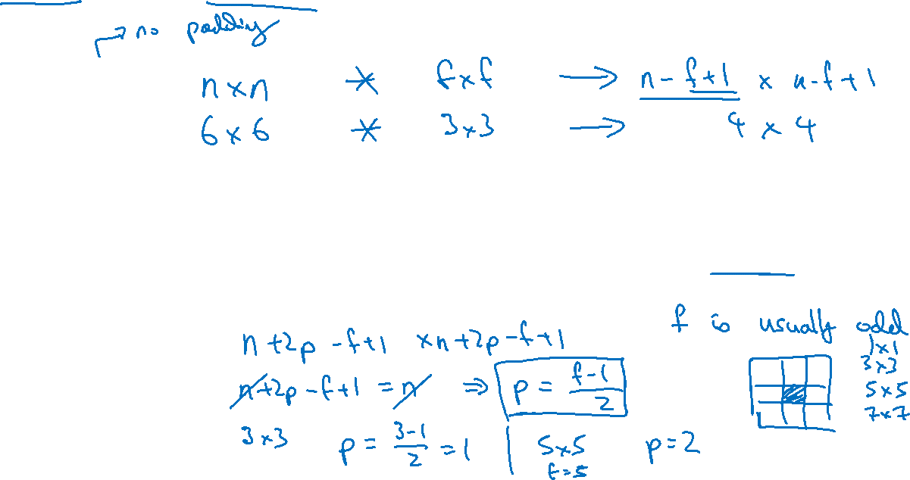
Valid and Same convolutions
“Valid”:
“Same”: Pad so that output size is the same as the input size.

